Slide 1

Academic Session 2025-26
ODD Semester Jul-Dec 2025
UNIVERSITY INSTITUTE OF ENGINEERING
COMPUTER SCIENCE ENGINEERING
Bachelor of Engineering
Semester: 6th
Design and Analysis of Algorithms
(23CSH-301/ITH-301)
Unit No. 1 Chapter No. 1 Lecture No. 5,6
Topic : recurrence equations and their solution: substitution method, recursion-tree method, master method
Richa Dhiman E11307 Assistant Professor

Slide 2
1
Learning Objectives & Outcomes
Objective:
To understand Recurrence relation and its various types.
Outcome:
Student will understand Recurrence relation and its various types and how to solve problems using these methods.

Slide 3
2
Recurrence Relation
A recurrence relation for the sequence, a0, a1, ...an, is an equation that relates an to certain of its predecessors a0, a1, ... , an-1.
Initial conditions for the sequence a0, a1, ... are explicitly given values for a finite number of the terms of the sequence.

Slide 4
3
Definition
A recurrence relation, T(n), is a recursive function of integer variable n.
Like all recursive functions, it has both recursive case and base case.
Example:

Slide 5
4
Definition (Contd…)
The portion of the definition that does not contain T is called the base case of the recurrence relation; the portion that contains T is called the recurrent or recursive case.
Recurrence relations are useful for expressing the running times (i.e., the number of basic operations executed) of recursive algorithms

Slide 6
5
Solving Recurrence Relation
To solve a recurrence relation T(n) we need to derive a form of T(n) that is not a recurrence relation. Such a form is called a “closed form” of the recurrence relation.
There are four methods to solve recurrence relations that represent the running time of recursive methods:
Iteration method (unrolling and summing)
Substitution method
Recursion Tree method
Master method

Slide 7
6
Iteration method
Steps:
Expand the recurrence
Express the expansion as a summation by plugging the recurrence back into itself until you see a pattern.
Evaluate the summation

Slide 8
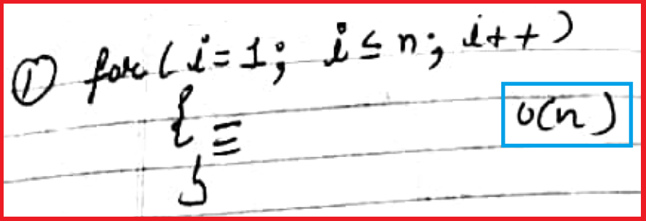
7
Example 1

Slide 9
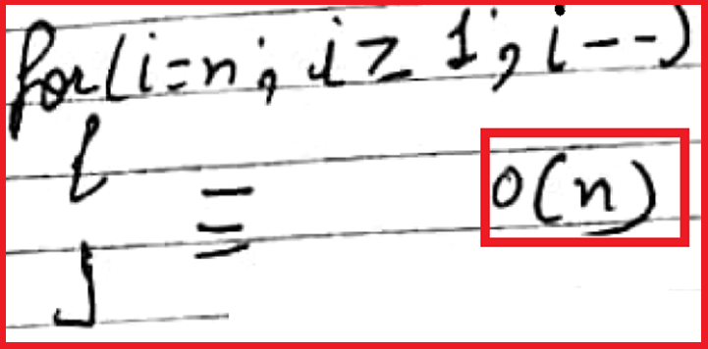
7
Example 2

Slide 10
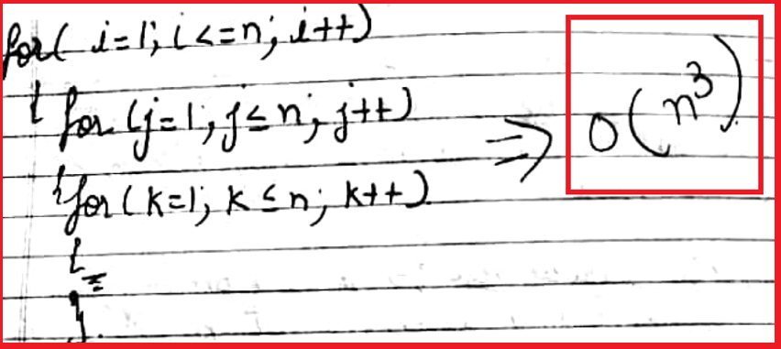
8
Example 3

Slide 11
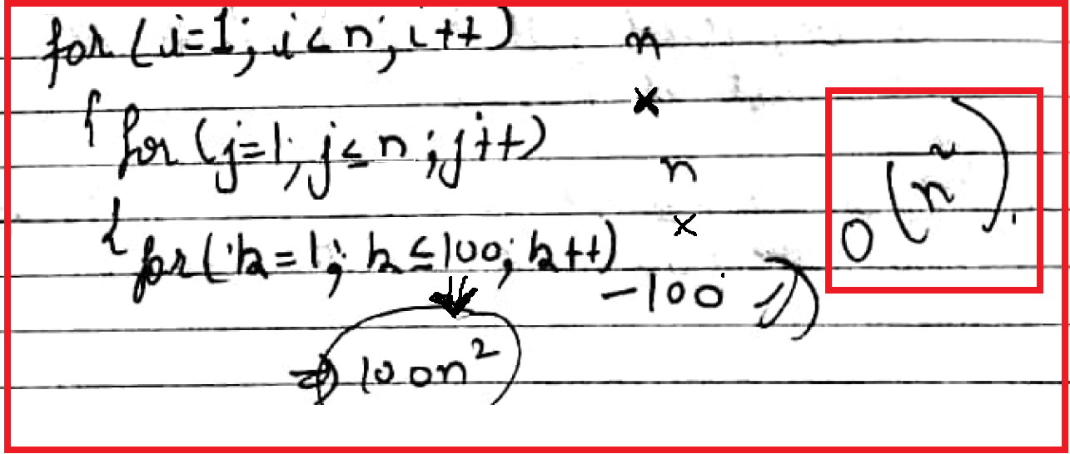
9
Example 4

Slide 12
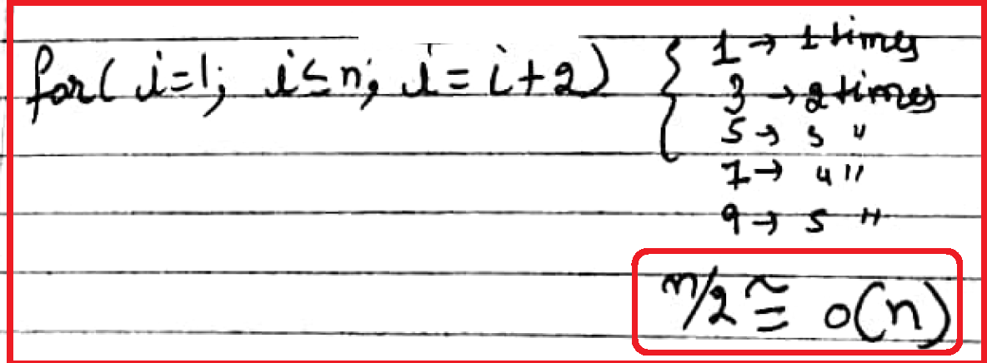
10
Example 5

Slide 13
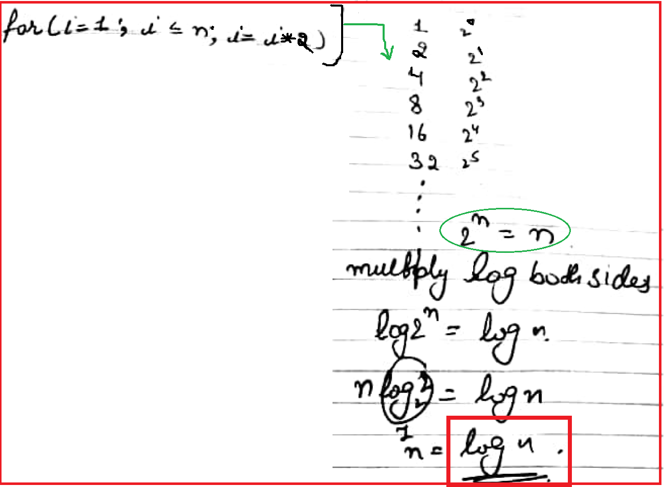
Example 6
11

Slide 14
12
Substitution Method
The substitution method
A.k.a. the “making a good guess method”
Guess the form of the answer, then use induction to find the constants and show that solution works
Run an example: merge sort
T(n) = 2T(n/2) + cn
We guess that the answer is O(n lg n)
Prove it by induction
Can similarly show T(n) = Ω(n lg n), thus Θ(n lg n)

Slide 15
13
Example of Substitution Method
Example: T(n) = 2T(n/2) + n
Guess T(n) ≤ cn log n for some constant c (that is, T(n)= O(n log n))
T(n) = 2T(n/2) + n ≤ 2(c n/2 log n/2 ) + n
= cn log n/2 + n
= cn log n − cn log 2 + n
= cn log n − cn + n
if c ≥ 1 , condition is satisfied.
Thus, T(n) = O(n log n)

Slide 16
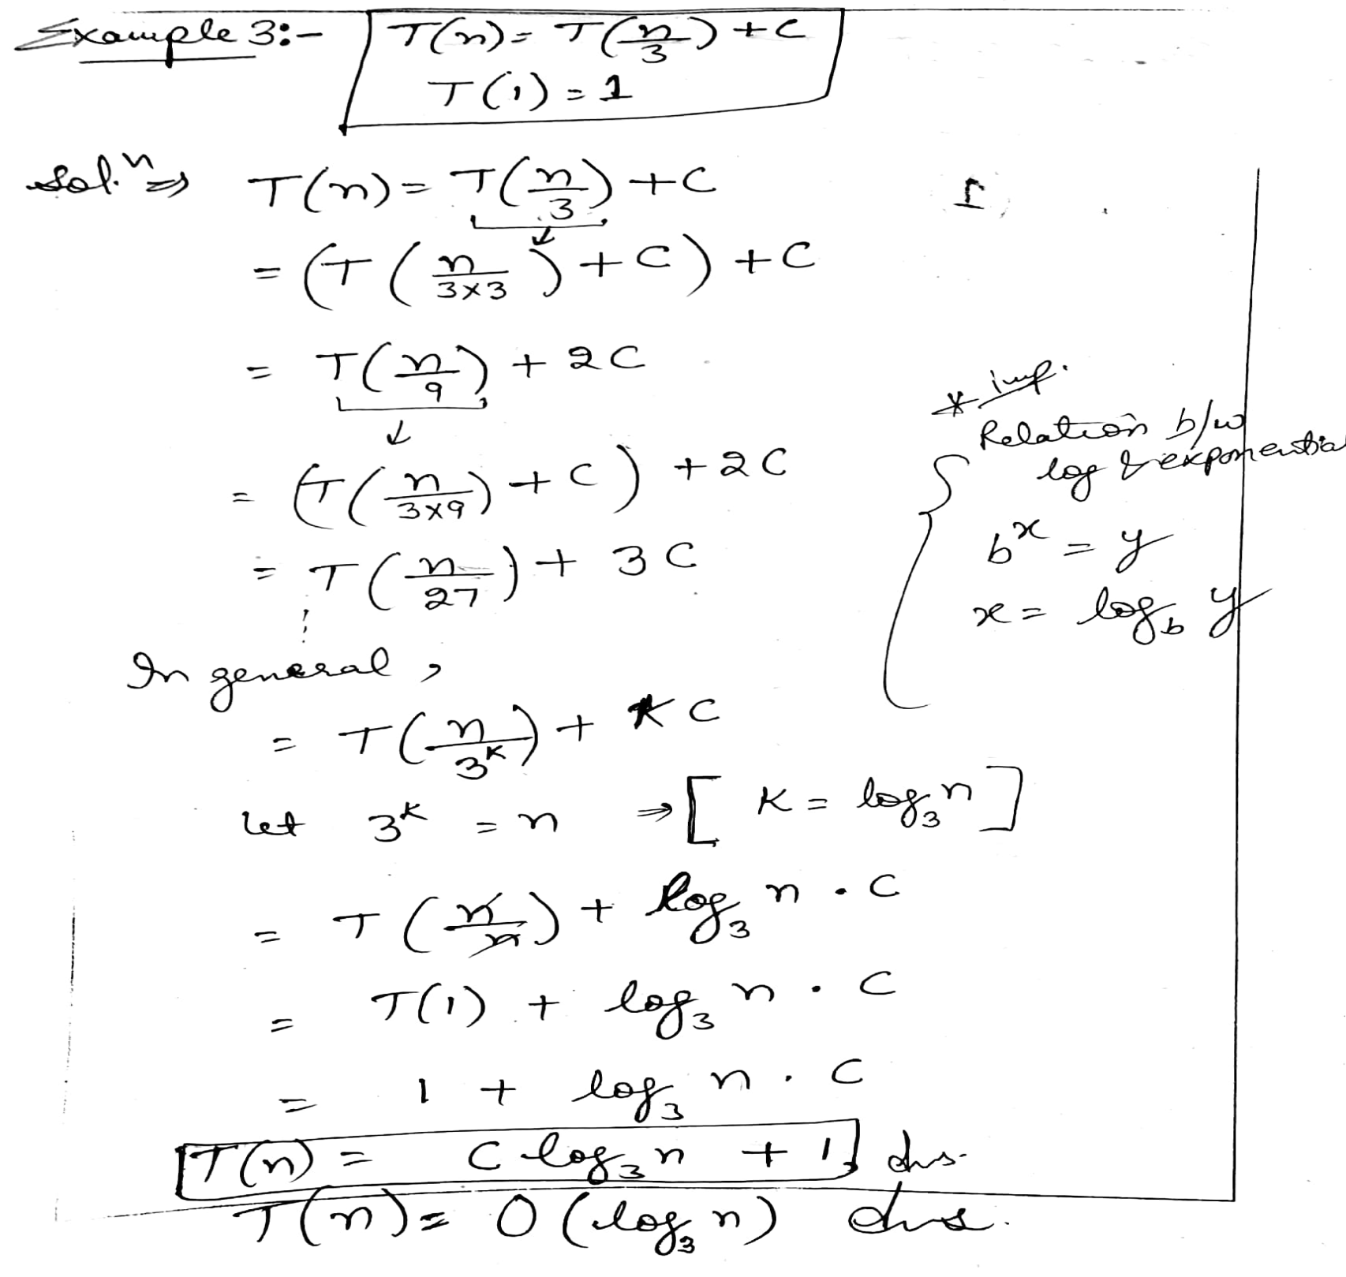
14

Slide 17
15
Recursive Tree Methods
A recursion tree models the costs (time) of a recursive execution of an algorithm.
Recursion Tree Method which is in the form of a tree where at each level nodes are expanded.
The recursion tree method is good for generating guesses for the substitution method.
In general, we consider the second term in recurrence as root.
It is useful when the divide & Conquer algorithm is used.

Slide 18
16
Recursive Tree Methods
The recursion-tree method can be unreliable.
The recursion-tree method promotes intuition, however.
In this case, only the largest term in the geometric series matters; all of the other terms are swallowed up by the Θ(·) notation.

Slide 19
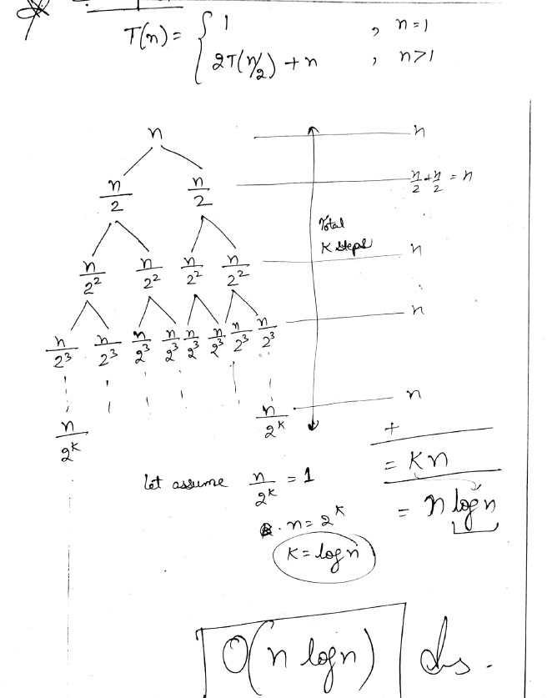
16

Slide 20
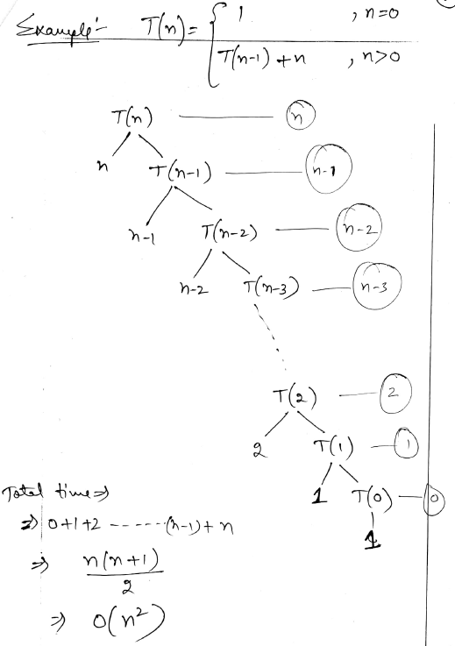
16

Slide 21
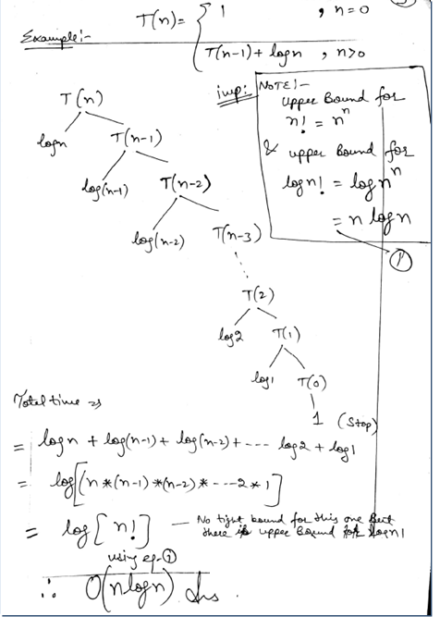
16

Slide 22
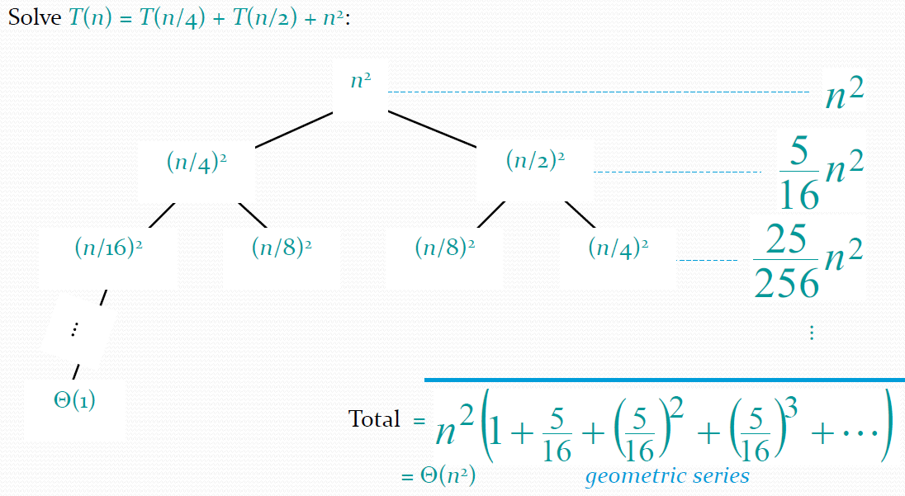
Example of recursion tree
16

Slide 23
16
The Master Theorem
Given: a divide and conquer algorithm
An algorithm that divides the problem of size n into a subproblems, each of size n/b
Let the cost of each stage (i.e., the work to divide the problem + combine solved subproblems) be described by the function f(n).
Then, the Master Theorem gives us a method for the algorithm’s running time:

Slide 24
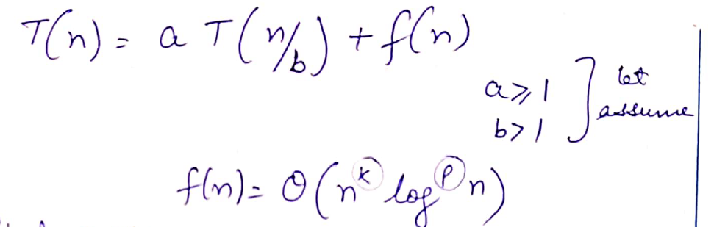
16

Slide 25
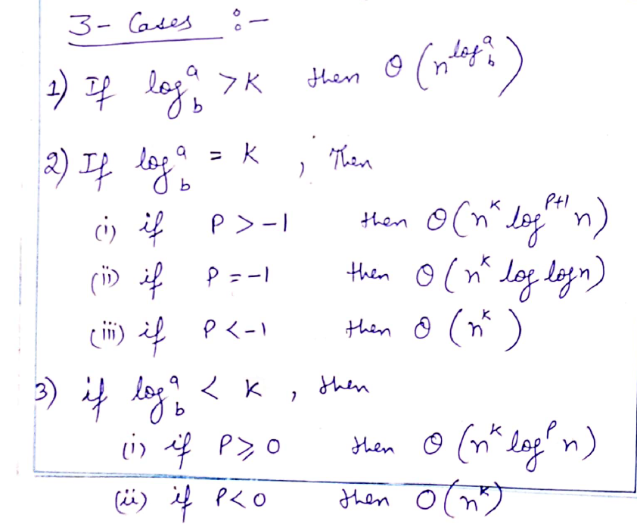
16

Slide 26
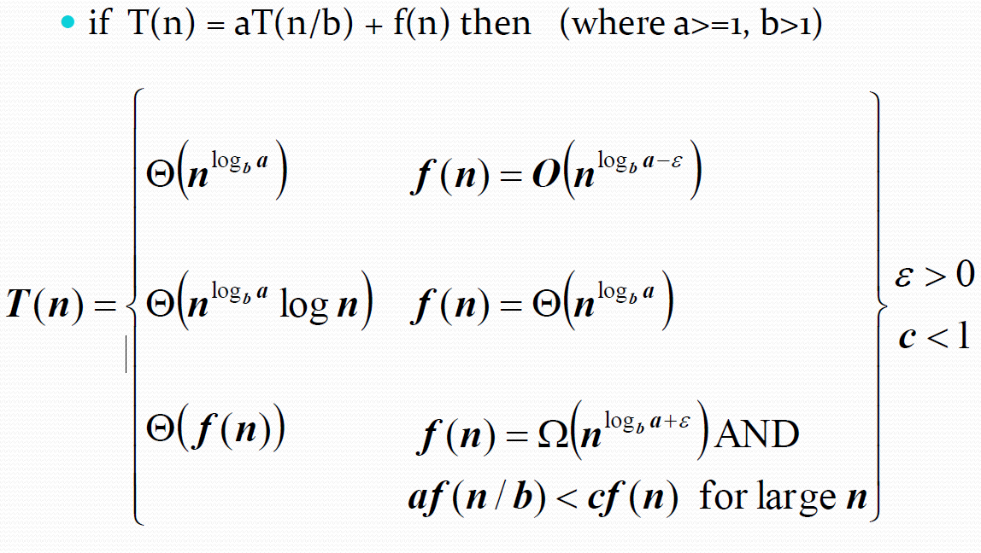
16
The Master Theorem (Contd..)

Slide 27
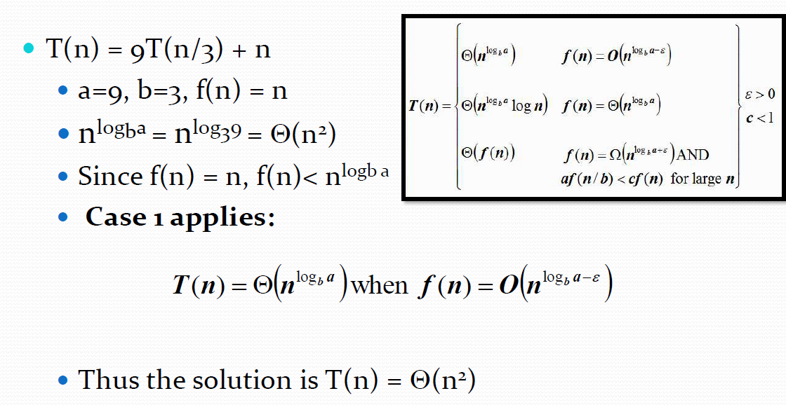
Using the Master Theorem
16

Slide 28
17
Summary
Recurrence Relation
Iteration method (unrolling and summing)
Recursion Tree method
Substitution method
Master method

Slide 29
18
Next Lecture
Arrays, Stack

Slide 30
19
Quiz
1) What is the time complexity of following code:
int a = 0;
for (i = 0; i < N; i++) {
for (j = N; j > i; j--) {
a = a + i + j;
}
}
O(N)
O(N*log(N))
O(N * Sqrt(N))
O(N*N)

Slide 31
19
Quiz
Find time complexity of given recurrence relation using Recurrence tree Method.
T(n)= 2T(n/2)+n for all n>1 ,
T(1)= 1 for n=1
O(n*n)
O(n log n)
O(n^2 log n)
O(n)

Slide 32
19
Quiz
2) Find time complexity of given recurrence relation using Recurrence tree Method.
T(n)= T(n-1)+n for all n>0 ,
T(1)= 1 for n=0
O(n*n)
O(n log n)
O(n^2 log n)
O(n)

Slide 33
20
References/ Articles/ Videos
Text books:
Cormen, Leiserson, Rivest, Stein, “Introduction to Algorithms”, Prentice Hall of India, 3rd edition 2012. problem, Graph coloring.
Horowitz, Sahni and Rajasekaran, “Fundamentals of ComputerAlgorithms”, University Press (India), 2nd edition
Websites:
https://www.javatpoint.com/daa-recurrence-relation#:~:text=Recurrence%20Relation,its%20values%20on%20smaller%20inputs.&text=For%20Example%2C%20the%20Worst%20Case,is%20described%20by%20the%20recurrence.

Slide 34
21
Faculty-curated videos, NPTEL, Coursera, LinkedIn, or other relevant learning resources
https://onlinecourses.nptel.ac.in/noc23_cs96/preview
https://nptel.ac.in/courses/106106131
https://nptel.ac.in/courses/106106208
https://www.linkedin.com/learning/learning-algorithms

Slide 35
23
Class-Wise Feedback

Slide 36
24
Thank You
For queries
Email: richa.e11307@cumail.in

